Slide 1
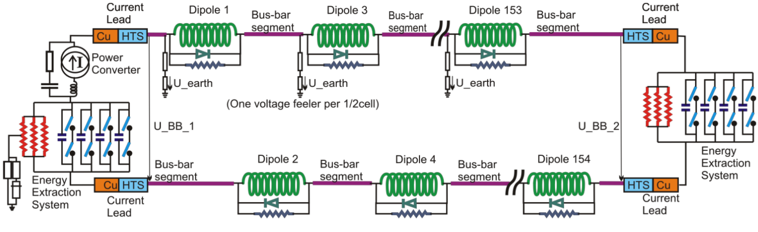
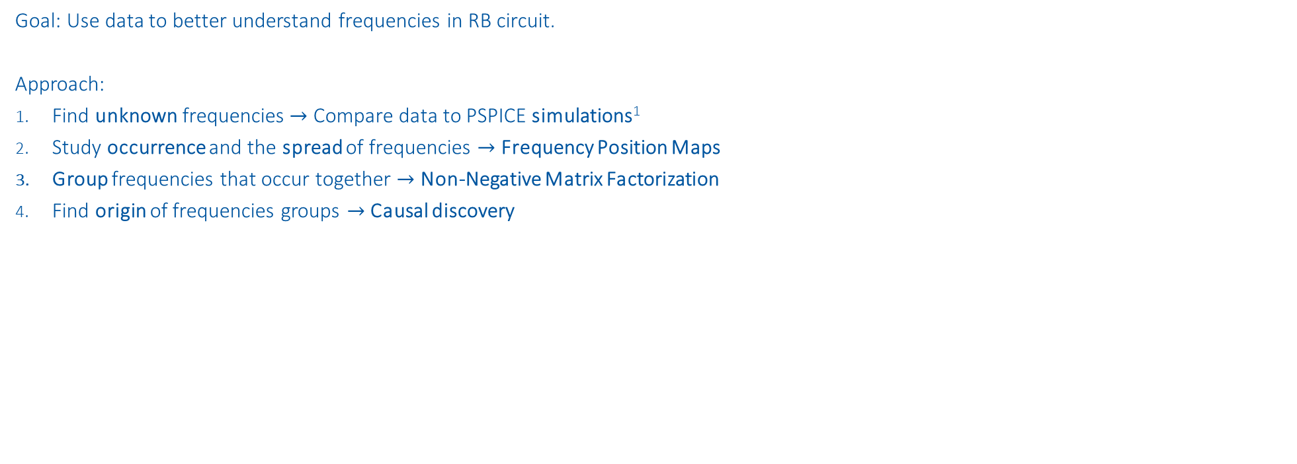
RB Frequency Analysis
Goal: Use data to better understand frequencies in RB circuit.
Approach:
Find unknown frequencies $→$ Compare data to PSPICE simulations¹
Study occurrence and the spread of frequencies $→$ Frequency Position Maps
Group frequencies that occur together $→$ Non-Negative Matrix Factorization
Find origin of frequencies groups $→$ Causal discovery
¹ contributed by MPE-PE STEAM-Team

Slide 2
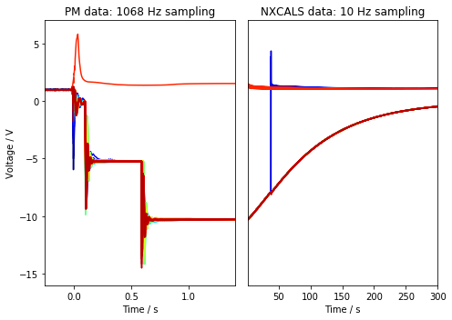
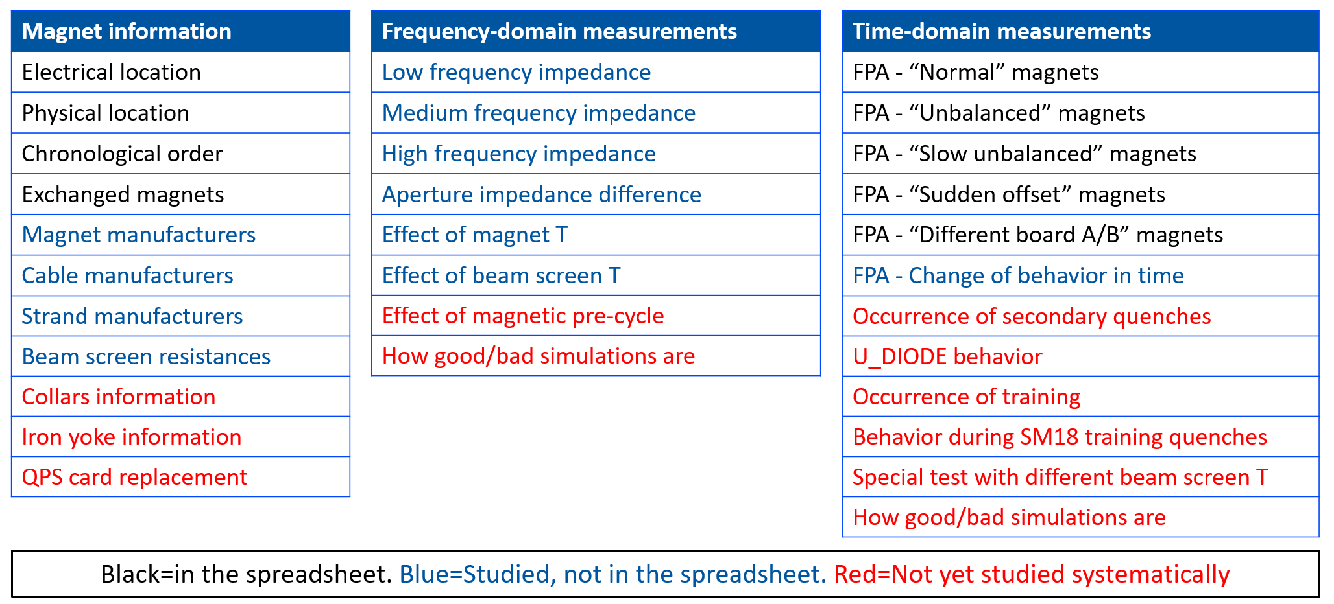
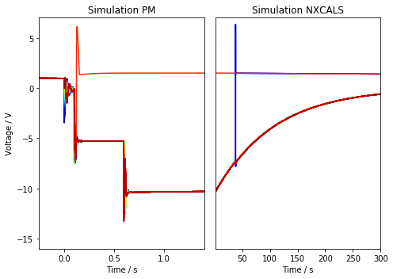
1. Compare data to PSPICE simulations
Initially analyze U_Diode data
Focus on plateaus after energy extraction
E. Ravaioli and M. Janitschke – Analyzing Fast Power Abort (FPA) tests
MP3 day – 2022/12/01
Event:
RB_RB.A78_1617170255140000000 2021-03-31 07:57:35.120000 Primary Quench at el. Position 141

Slide 3
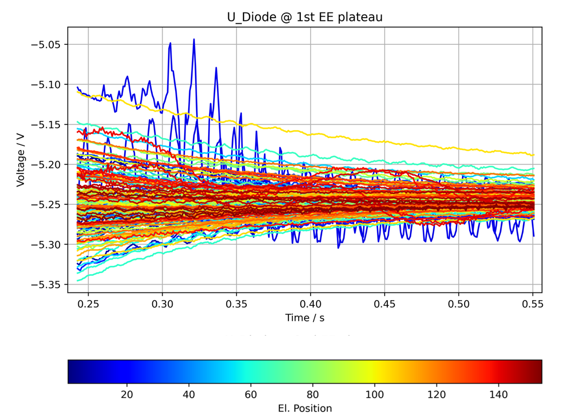
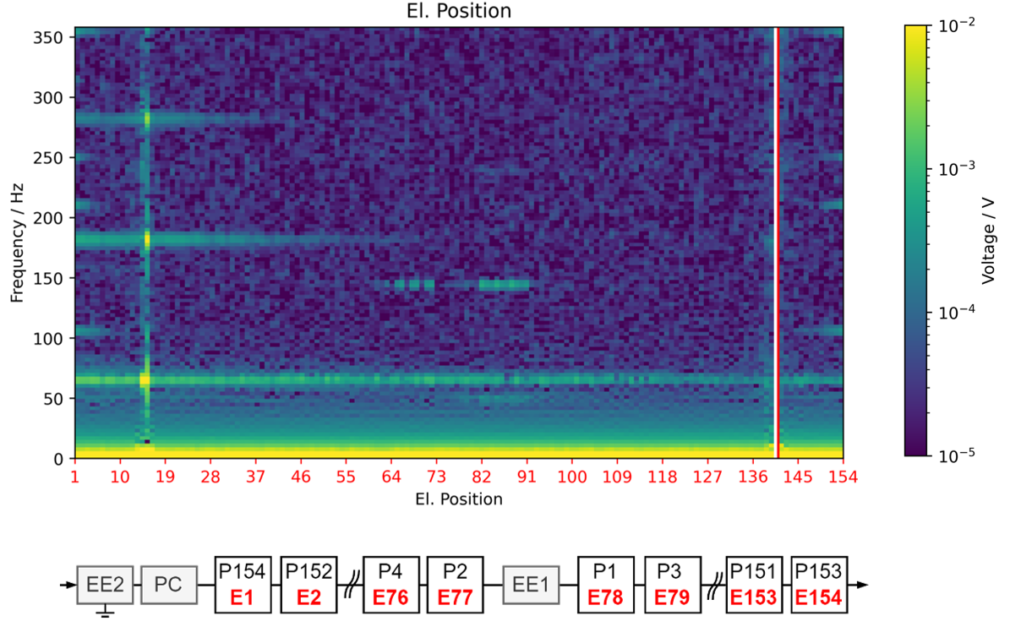
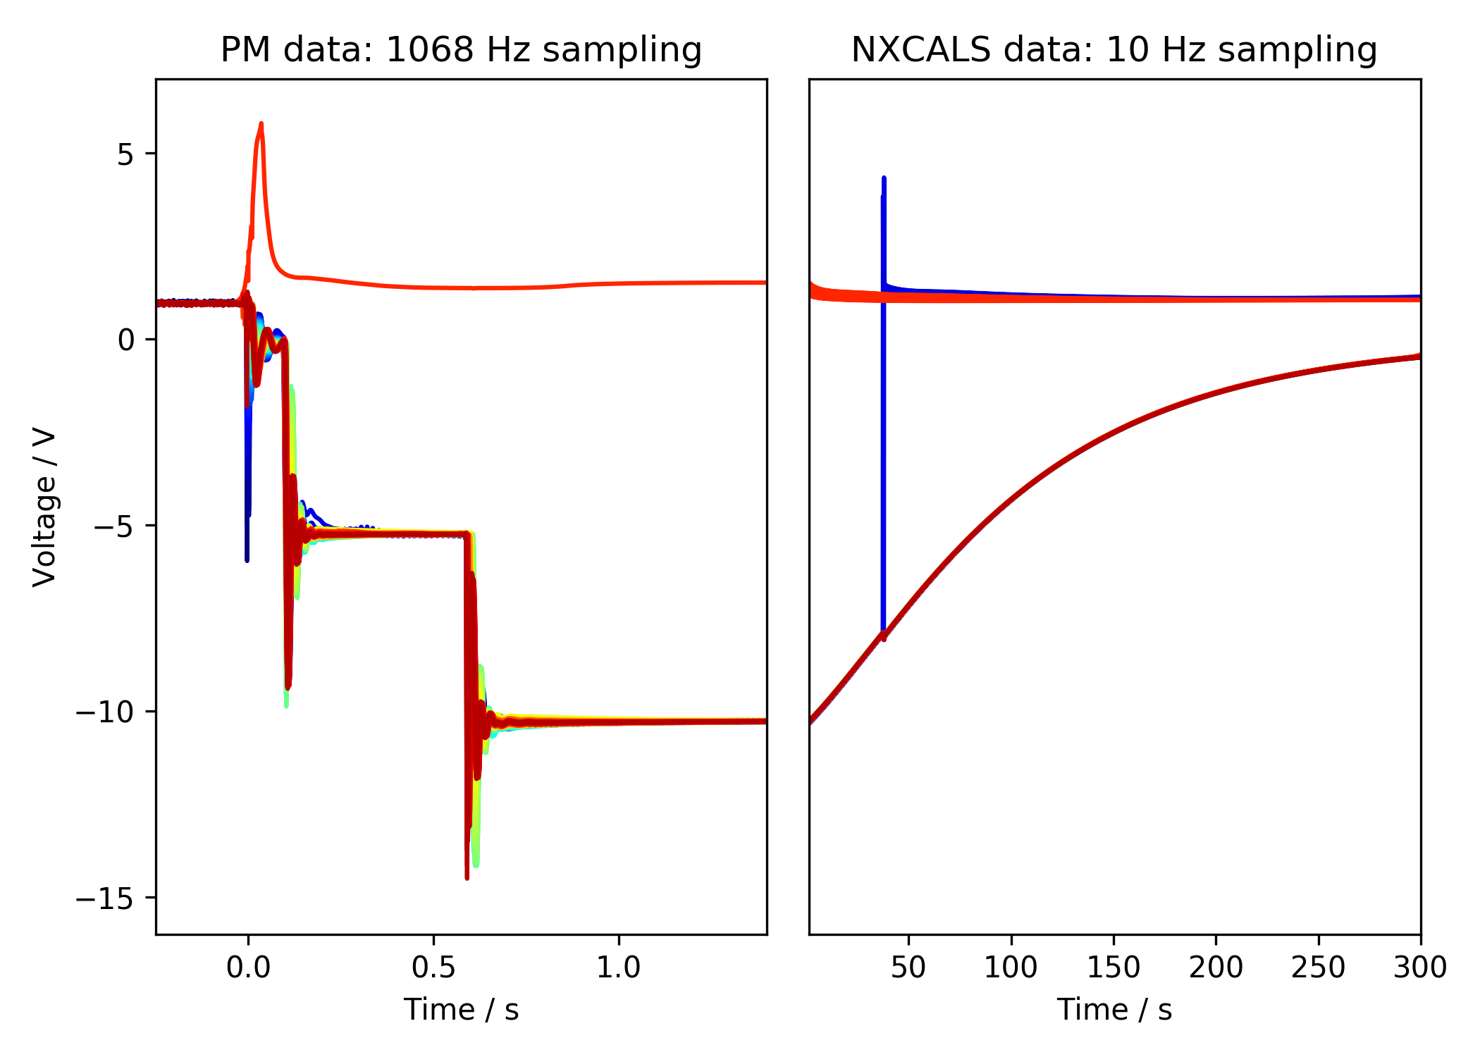
2. Frequency Position Maps
Fast Fourier transform U_Diode plateaus
1st EE
Plateau
fft
2nd EE
Plateau
2nd EE switch off
1st EE switch off
PC Switch off
Event:
RB_RB.A78_1617170255140000000 2021-03-31 07:57:35.120000 Primary Quench at el. Position 141

Slide 4
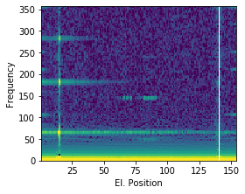
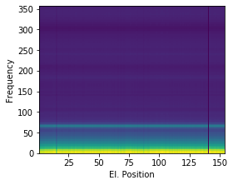
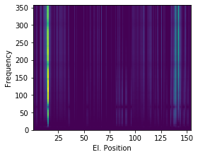
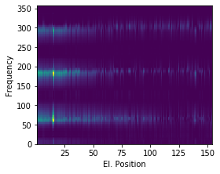
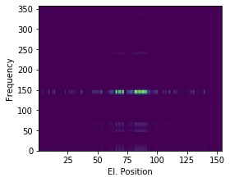
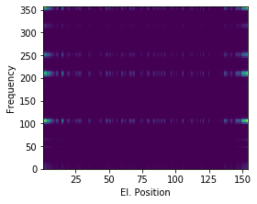





3. Non-Negative Matrix Factorization
Group frequencies that occur together
$$≈$$
$$+$$
$$+$$
$$+$$
$$+$$
correlation to
correlation to
correlation to
correlation to
correlation to
Common Oscillation
Physical Propagation
Electrical Propagation
QPS crate
Power Converter in RB.A78

Slide 5
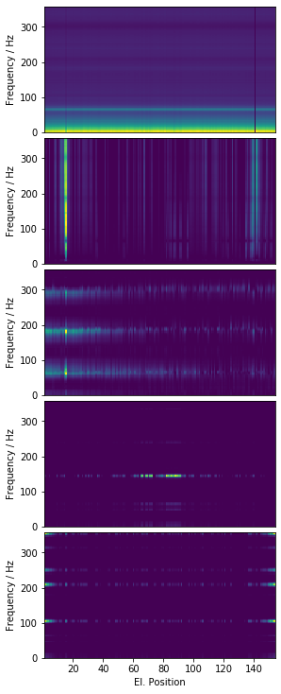
3.1 Correlation of components
Component Number | Component | Dominant Frequencies [Hz] | Highest Correlation to | Source Direction | Domain Expert
1 |  | Offset (low frequency) | Circuit Current Quenched Magnet Manufacturer EE Voltage Quenched Magnet Outer Cable Type Circuit | Any | Zinur Charifoulline
2 |  | Offset (high frequency) | Quenched Magnet Manufacturer Date Quenched Magnet Outer Cable Type Circuit Current EE Voltage | Quench | Zinur Charifoulline
3 |  | 65, 184, 302 | Circuit Quenched Magnet Outer Cable Type Quenched Magnet Manufacturer EE Voltage Quenched Magnet Inner Cable Type Quenched Magnet Age | Quench | Zinur Charifoulline
4 |  | 143 | Circuit Energy Extraction Resistance Earth Current Magnet Outer Cable Type Magnet Inner Cable Type | QPS Crate | Jens Steckert, Zinur Charifoulline
5 |  | 106, 209, 252, 355 | Circuit Magnet Outer Cable Type Diode Type | Power Converter RB.A78 | Hugues Thiesen, Yves Thurel, Zinur Charifoulline

Slide 6
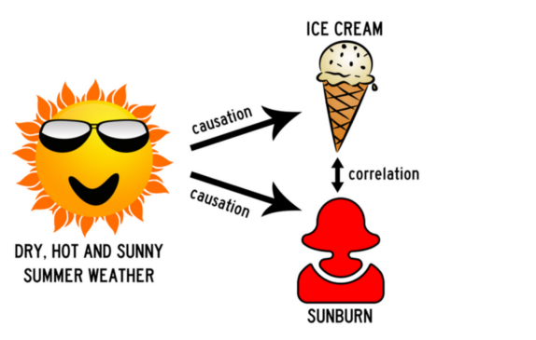
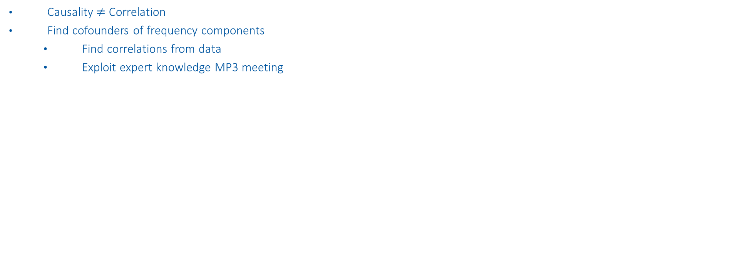
4. Causal discovery
Causality $≠$ Correlation
Find cofounders of frequency components
Find correlations from data
Exploit expert knowledge MP3 meeting
Cofounder

Slide 7
Questions
What decisions can be made out of this analysis
To MP3 team:
What are possible cofounders

